Slide 1


Slide 2
Data Science Batch
Module 1 : Introduction to Data Science
Topics
Introduction to Data Science
Introduction to Programming
Introduction to Python: Installation and Running
Jupyter Notebook
Running .py file from terminal
Google Colab

Slide 3
Introduction to Data Science?

Slide 4
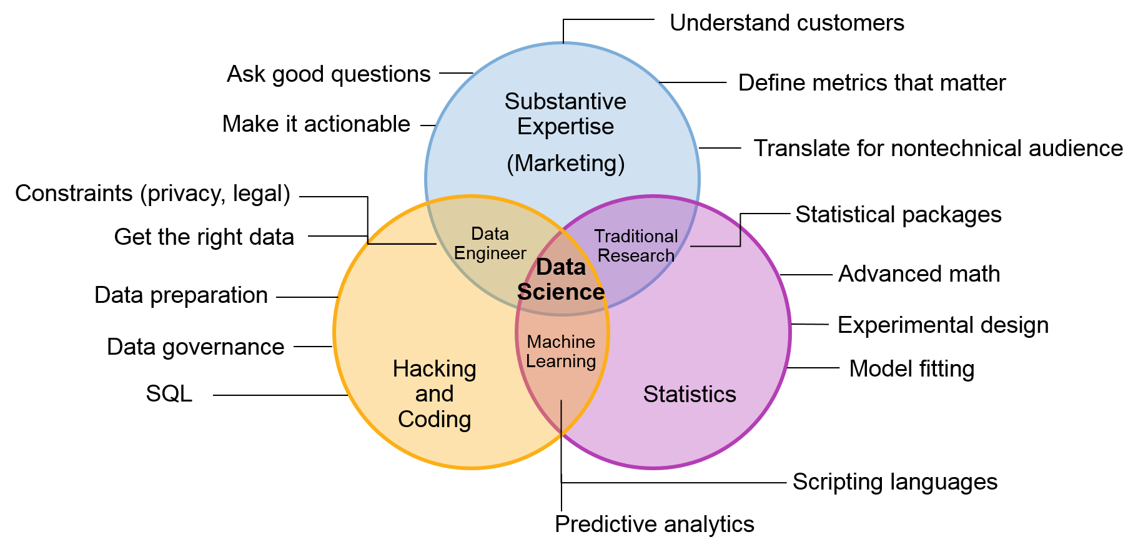
Domain Knowledge
Computer Science
Mathematics & Statistics

Slide 5
Why Data Science?
Every year, the world creates huge amounts of data that’s only accelerating.
Companies now have access to unprecedented amounts of data, which they need to process and understand.
Data scientists are responsible for transforming this growing ocean of data into valuable and actionable information.
The Bureau of Labor Statistics projects 31.4 percent employment growth for data scientists between 2020 and 2030. In that period, an estimated 19,800 jobs should open up.

Slide 6
Top Skills for Data Scientists
Programming
DBMS
Mathematics and Statistics
Data Visualisation
Machine learning
Deep Learning
Communication Skills

Slide 7
Roles and Responsibilities
On a more technical level, the core job responsibilities of a data scientists include:
Using database tools and programming languages to obtain, manipulate and analyse data.
Creating machine learning algorithms across traditional and deep learning.
Analysing historical data to identify trends and support optimal decision-making.
Communicating with both technical and non-technical stakeholders.
Keeping up-to-date with advancements in technology.

Slide 8

Introduction to Programming

Slide 9
What is Programming Language
A Programming language is a set of rules that provides a way of telling a computer what operations to perform.
A program is set of instructions that is executed by a computer to accomplish a particular task.
It Provides a linguistic framework for describing computations.
It is set of rules for communicating an algorithm
It is a notational system for describing computation in a machine readable and human readable form.

Slide 10
What is Programming Language
Any Common human language has words, vocabulary, symbols and Grammatical rules.
Programming languages also have words, vocabulary, symbols and Grammatical rules.
These grammatical rules are called as syntax.
Each programming language has a different set of syntax rules.

Slide 11
What is Programming Language
Computer Programmer
Someone who can write computer programs or in other words, someone who can do computer programming is called a Computer Programmer.
Algorithm
An algorithm is a step-by-step procedure to resolve any problem. An algorithm is an effective method expressed as a finite set of well-defined instructions.
Example :
Let a1,a2,a3,….,a100 be any random number selected between 1 and 100.
If a1 is prime then add to a list called as list_prime.
If a1 is composite then add to a list called as list_composite.
Skip to next number.
Find out sum of numbers in the list_prime.
Find out sum of numbers in the list_composite.

Slide 12
What is Python ?

Slide 13
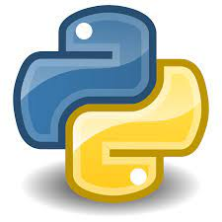
Python
Python is a high-level, general-purpose and a very popular programming language.
Python programming language (latest Python 3) is being used in web development, Machine Learning applications, along with all cutting edge technology in Software Industry.
Advantages of Python
Works on different platforms (Windows, Mac, Linux, Raspberry Pi, etc).
Simple syntax similar to the English language.
Syntax that allows developers to write programs with fewer lines than some other programming languages.
Runs on an interpreter system, meaning that code can be executed as soon as it is written. This means that prototyping can be very quick.
Supports functional and structured programming methods as well as OOP.
Provides very high-level dynamic data types and supports dynamic type checking.
Can be easily integrated with Other Languages.

Slide 14
Why Python is preferred in Data Science ?

Slide 15
Python in Data Science
As a new Data Scientist, you know that your path begins with programming languages you need to learn.
Python is the most popular language for all Data Scientists.
But Why is this?
Reasons behind Python's popularity in Data Science
Python is a free and open-source language
Simple Syntax as compared to other languages
Availability of large number of libraries and frameworks (NumPy, Pandas ,matplotlib …)
Scalability
Efficient Deep Learning
Huge Community
Jobs and Growth in market

Slide 16
Installation

Slide 17
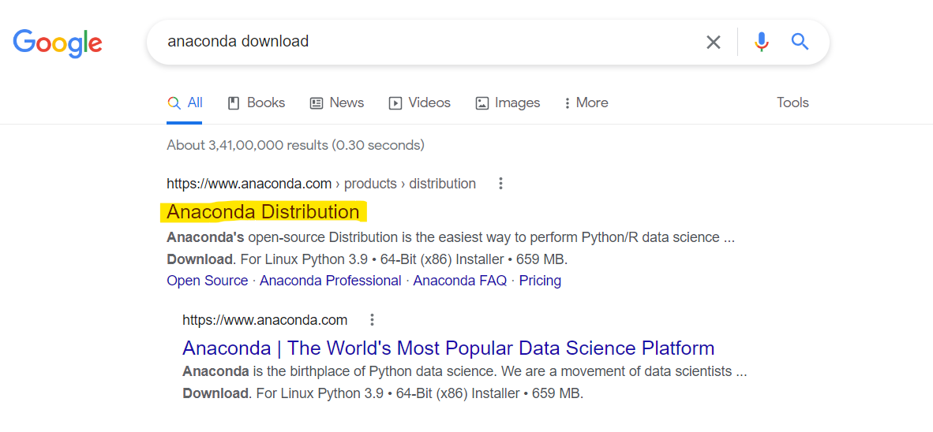
Steps of installation
Step 1)
Go to
https://www.anaconda.com/products/distribution

Slide 18
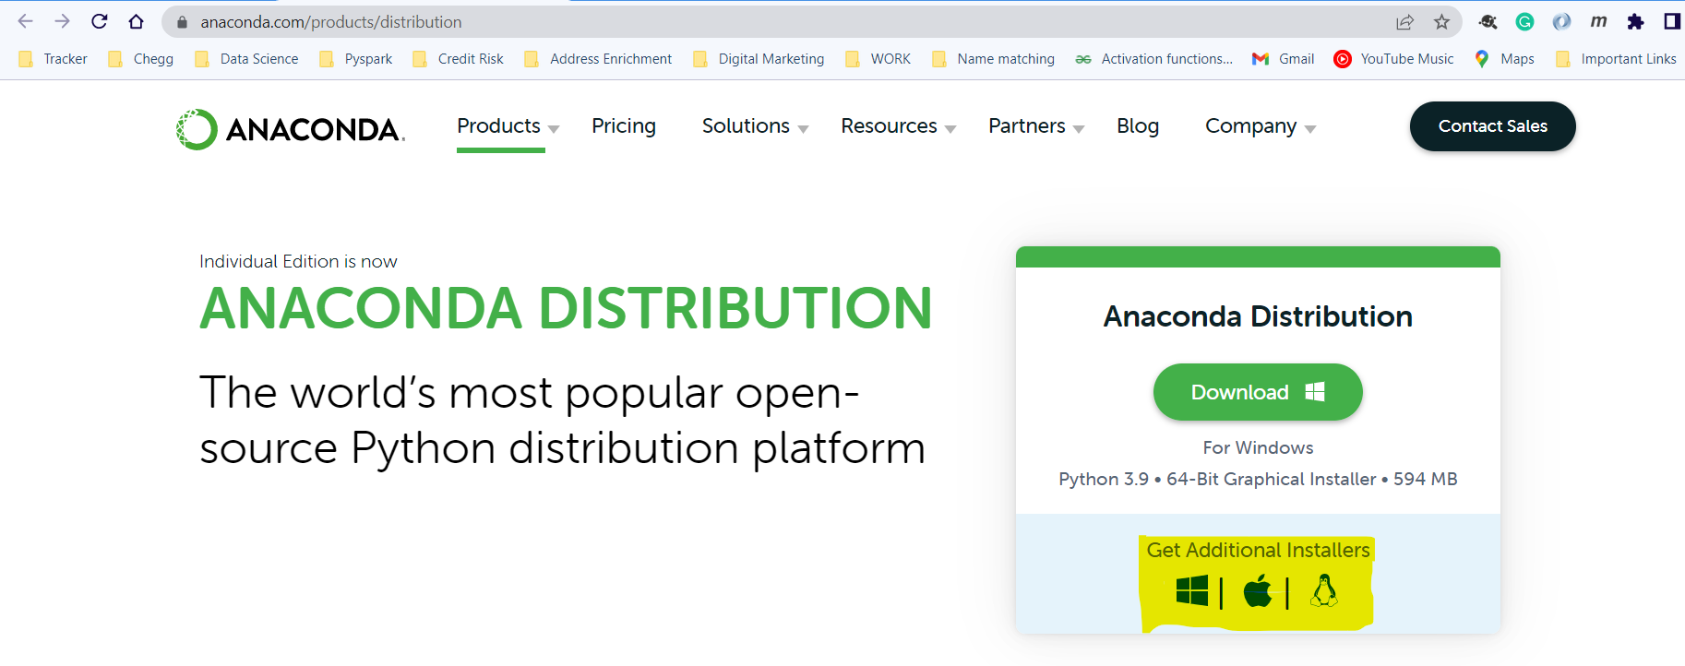
Steps of installation
Step 2)
Select Your Operating System (Default download link is for windows operating system.)

Slide 19
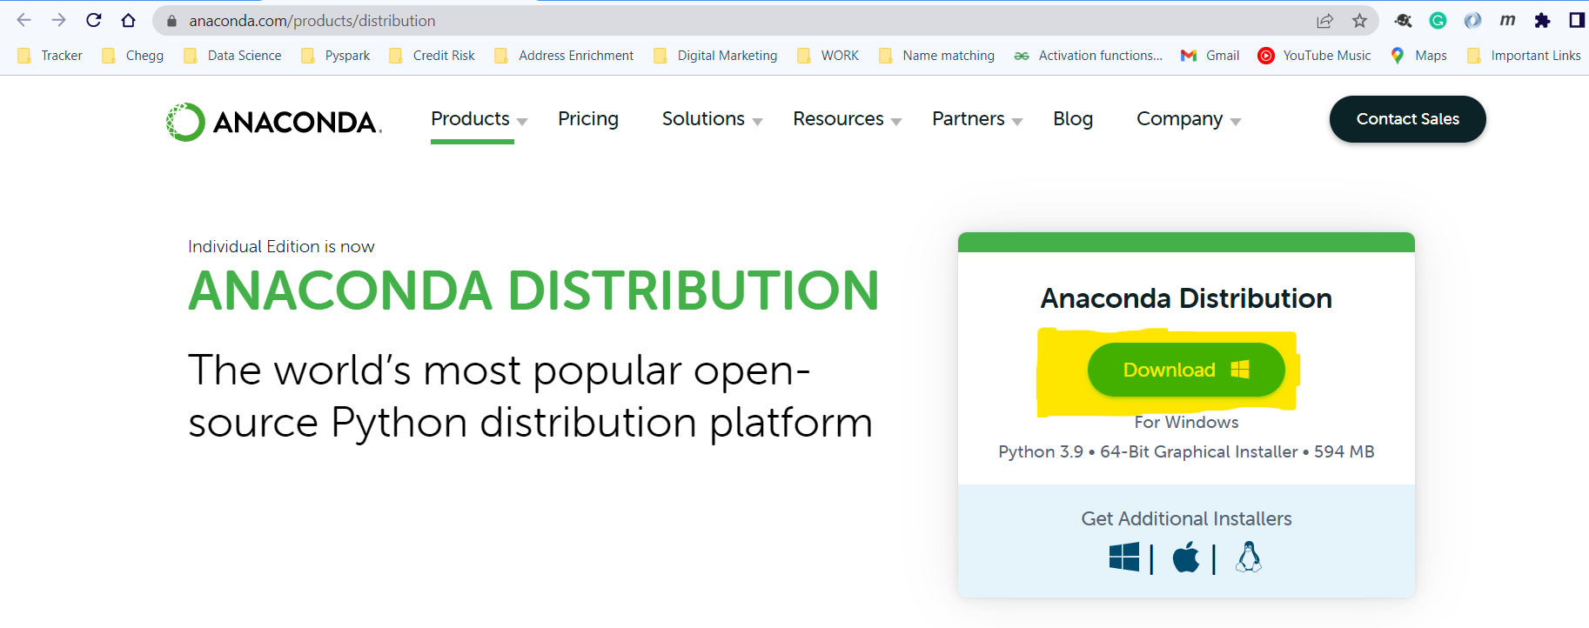
Steps of installation
Step 3)
Once you have selected your operating system click on download button.

Slide 20
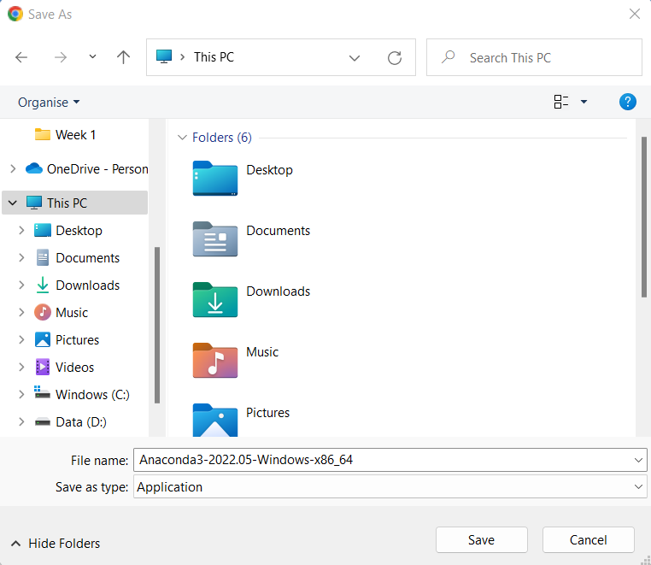
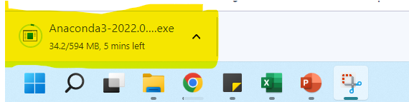
Steps of installation
Step 4)
Select the directory where you want to download your software and your download will start.

Slide 21
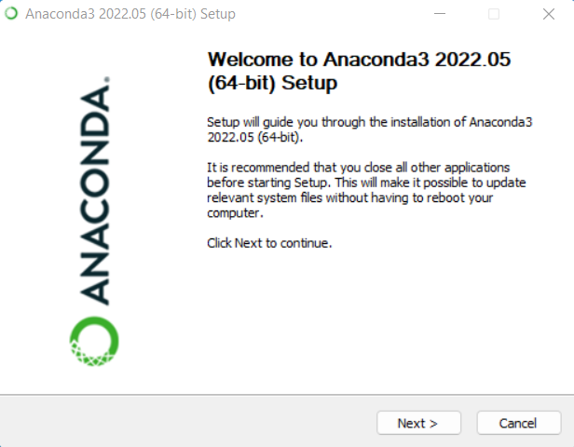
Steps of installation
Step 5)
Open your setup file which you have downloaded and select your default settings at each step and at last click on finish.

Slide 22
Introduction to Jupyter Notebook

Slide 23

Jupyter Notebooks
A Jupyter Notebook is an open source web application that allows data scientists to create and share documents that include live code, equations, and other multimedia resources.
Use of Jupyter Notebook:
Jupyter notebooks are used for all sorts of data science tasks such as exploratory data analysis (EDA), data cleaning and transformation, data visualization, statistical modeling, machine learning, and deep learning.
Advantage of Using Jupyter Notebook :
Useful for "showing the work" through a combination of code, markdown, links, and images.
Jupyter notebooks can also be converted to a number of standard output formats (HTML, PowerPoint, LaTeX, PDF, Restructured Text, Markdown, Python)

Slide 24
Working of Jupyter Notebook

Slide 25
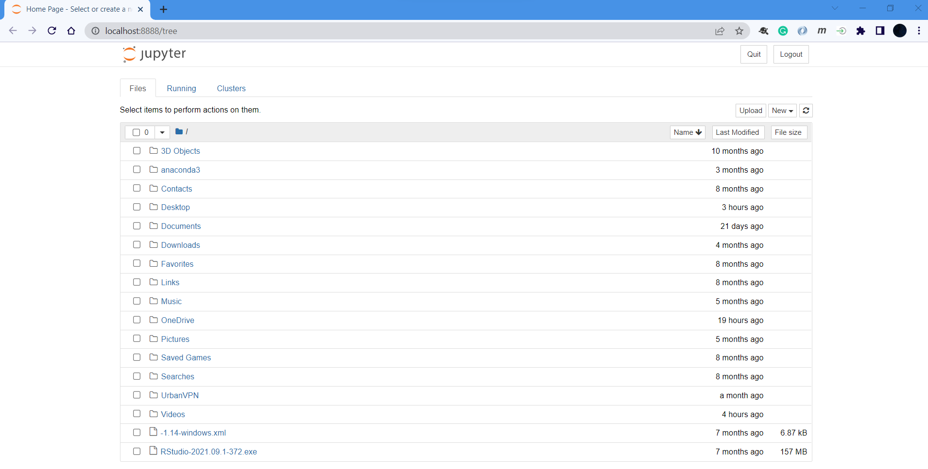
Step 1) Open Jupyter Notebook from apps Step 2) In your default browser a web page will open like this and default directory will be C drive of your system.
Working of Jupyter Notebooks

Slide 26
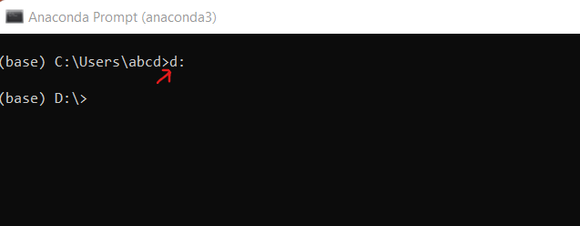
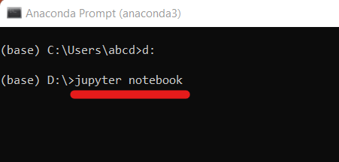
Working of Jupyter Notebooks
Step 3) If you want to run and save your code in other directory then follow these steps:
1) Open Anaconda Prompt (anaconda3) from start menu. 2) Type the directory name followed by colon (:) and then press Enter (Example – d:) 3) Type jupyter notebook and then Enter.

Slide 27
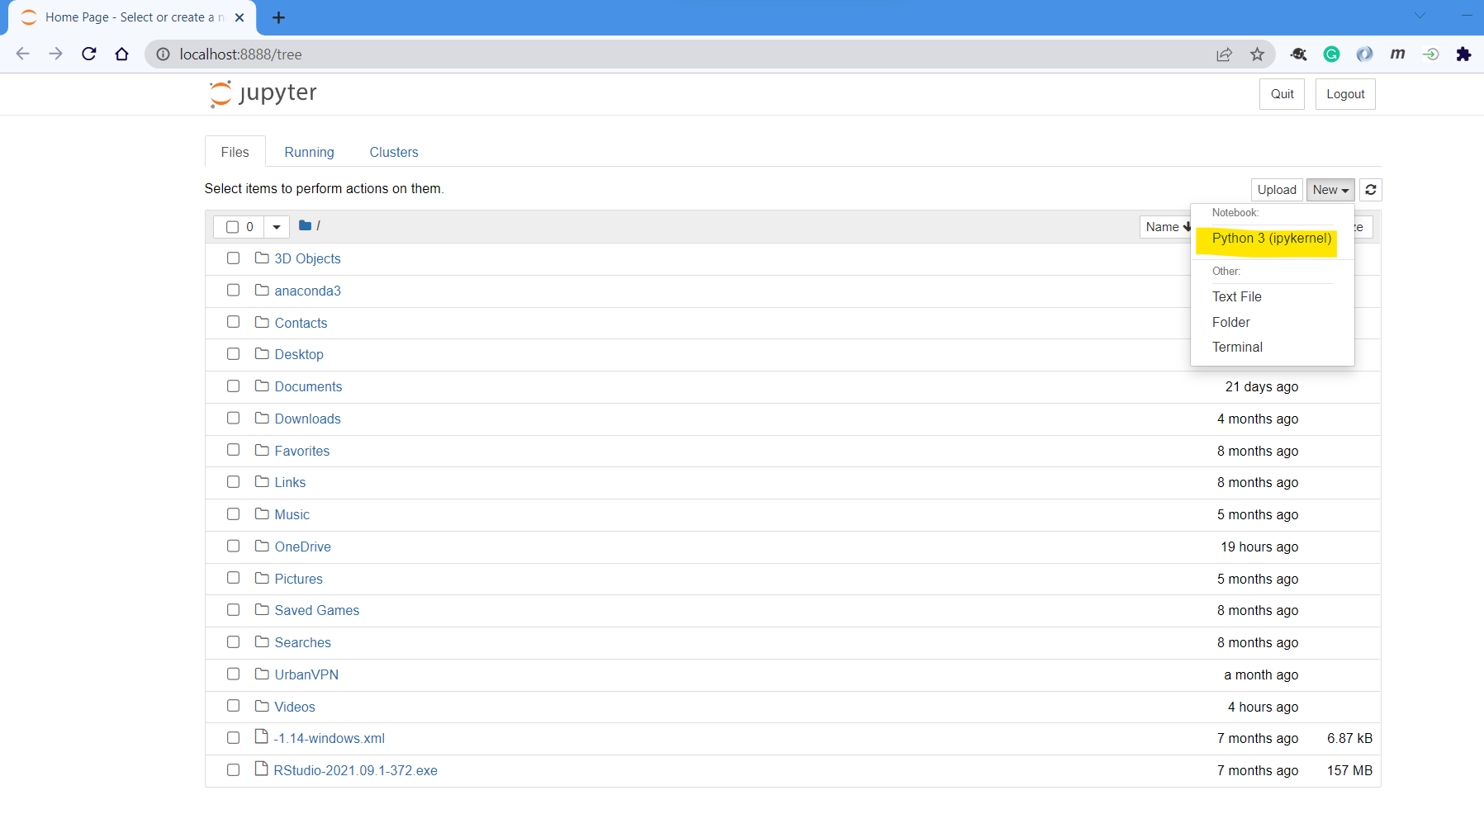
Step 4) Open your preferred folder and then click on New -> Python 3.
Working of Jupyter Notebooks

Slide 28
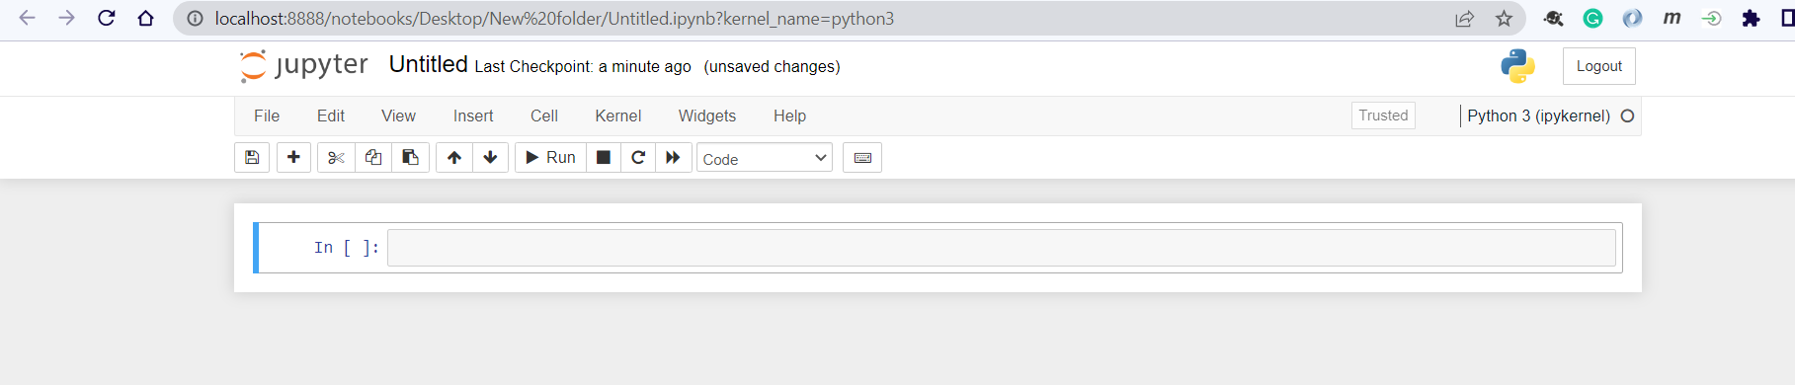
Step 5) A new notebook will be opened with name ‘Untitled.ipynb’ and you can run your code here.
Working of Jupyter Notebooks

Slide 29
Commands and Shortcut of Jupyter Notebooks
Action | Menu | Keyboard Shortcuts
Run selected cells | Cell -> Run Cells | Ctrl + Enter
Run the current cell and go down | Cell -> Run Cells and Select Below | Shift + Enter
Save and checkpoint | File -> Save and Checkpoint | Ctrl + S
Insert cell above | Insert -> Insert Cell Above | A
Insert cell below | Insert -> Insert Cell Below | B
Change the cell type to Code | Cell -> Cell Type -> Code | Y
Change the cell type to Markdown | Cell -> Cell Type -> Markdown | M
Code completion or indent |  | Tab

Slide 30
How to run .py file
from Terminal

Slide 31

Spyder
Steps to Run .py scripts
Open Spyder from apps installed in your system.
Write and save your code in your preferred directory, it will be saved as .py extension.
Open Anaconda Command Prompt.
Go to the directory in which you have saved the .py file using below command
cd path_to_directory
5) Run your script using below command:
Python scriptname.py

Slide 32
Google Colab

Slide 33

Google Colab
Colab is a free Jupyter notebook environment that runs entirely in the cloud.
It does not require a setup.
Notebooks that you create can be simultaneously edited.
Supports many popular machine learning libraries which can be easily loaded in your notebook.
You can perform the following using Google Colab:
Write and execute code in Python
Create/Upload/Share notebooks
Import/Save notebooks from/to Google Drive
Import/Publish notebooks from GitHub
Import external datasets e.g. from Kaggle
Integrate PyTorch, TensorFlow, Keras, OpenCV
Free Cloud service with free GPU/TPU.

Slide 34
Google Colab
Steps to use Google Colab
Step 1 )
Log in to your Google account in your browser.
Step 2 )
Open the following link : https://colab.research.google.com
Once you open this link a demo notebook will be opened.
Step 3)
Go to File -> New Notebook
A new notebook will open similar to Jupyter Notebook.
Step 4)
Write your code and Save it.
It will be saved in your Google Drive.
Note : If you want to find the location of your file then Go to File -> Locate in Drive

Slide 35


